Slide 1
ESP32 Docs RAG
MONGODB STUDENT HACKATHON (SVNIT) · TRACK 2: RAG ENGINE
An evidence-backed assistant for the ESP32 chip family
Team Complex
ESP32 Docs RAG · 1/10

Slide 2
Chip docs are easy to mix up
THE PROBLEM
ESP32, S3, C3, C6, H2 and P4 each have their own datasheet and errata, hundreds of pages each
The same section names (GPIO, pin overview, boot) repeat across chips, so facts get mixed between chips
Datasheets and errata can qualify or contradict each other
ESP32 Docs RAG · 2/10

Slide 3
A RAG app that answers from the docs only
THE SOLUTION
Grounded
Cited
Honest
Answers hardware questions only from the official docs.
Cites the exact PDF and page for every claim.
Says “not enough information” when the docs don’t support an answer, e.g. Wi-Fi on a chip with no radio.
ESP32 Docs RAG · 3/10

Slide 4
Official Espressif docs, 6 chips
THE DATA
S3
C3
C6
H2
P4
Datasheet + errata PDFs for each of the 5 versions
Plus a few supporting notes/pages
Chunks indexed so far
[Around 1,234 chunks]
ESP32 Docs RAG · 4/10

Slide 5
From PDF to cited answer
ARCHITECTURE
1 · Parse
2 · Chunk
3 · Embed
PyMuPDF; headers/footers removed; sections from PDF bookmarks
→
About 1200 characters, never crossing a page
→
voyage-4-nano, local, 1024-dim. Chip name + doc type added to the text
4 · Store
5 · Retrieve
6 · Generate
MongoDB Atlas, one document per chunk
→
Atlas Vector Search (cosine); chip filter when a chip is named
→
Gemini, restricted to retrieved passages; [S1], [S2] citations
ESP32 Docs RAG · 5/10

Slide 6
One document holds it all
MONGODB USAGE
Document model: text + vector + metadata together
Atlas Vector Search index on the embedding field
Filter fields: chip and doc_type
Idempotent ingestion: content-hash IDs, re-runs skip unchanged chunks
One document per chunk
text
embedding
chip
doc_type
page
section
source_id
A second collection holds source file records
ESP32 Docs RAG · 6/10

Slide 7
Four steps
DEMO FLOW
1 · Add documents
2 · Ask across chips
3 · Open citations
4 · Ask the unanswerable
The ingestion script turns PDFs into searchable chunks.
See the exact PDF pages used.
“Compare Wi-Fi and Bluetooth support of ESP32-C3, C6 and H2”
“What is the Wi-Fi throughput of the ESP32-P4?” The system refuses to invent an answer.
ESP32 Docs RAG · 7/10

Slide 8
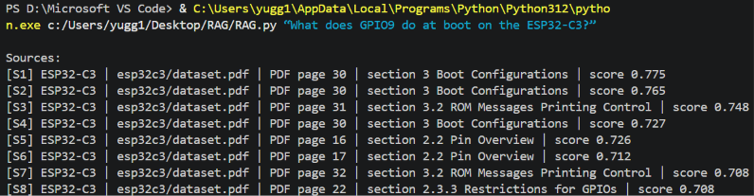
GPIO9 at boot on the ESP32-C3
EXAMPLE RESULT
“What does GPIO9 do at boot on the ESP32-C3?”
GPIO9 is a strapping pin selecting the boot mode (SPI boot vs download boot)
Cited: ESP32-C3 datasheet, pages 30–31
All 8 retrieved passages came from the correct chip
ESP32 Docs RAG · 8/10

Slide 9
What we hit and how we handled it
CHALLENGES & LEARNINGS
Solved by putting the chip name in the embedded text and filtering by chip
Mixing chips
Cloud embedding API rate limits
Switched to a local open-weight model
Section labels come from PDF bookmarks and can be off at section boundaries; page numbers are exact. Tables parse imperfectly.
Known limitation
ESP32 Docs RAG · 9/10

Slide 10
NEXT STEPS
Where this goes next
Retrieval test set with expected source IDs
Hybrid search (keyword + vector) for exact tokens like GPIO9 and register names
Better table handling and heading detection
Web UI with clickable citations
Thank you
GitHub Repo Link :https://github.com/yugg1108/RAG-System-for-ESP32-S3-C3-C6-H2-P4
ESP32 Docs RAG · 10/10

